Slide 1
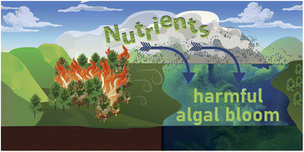
Wildfires and Water Quality
Carly Bauer and Madeline Schreiber, Virginia Tech
(Olson et al., 2023)

Slide 2
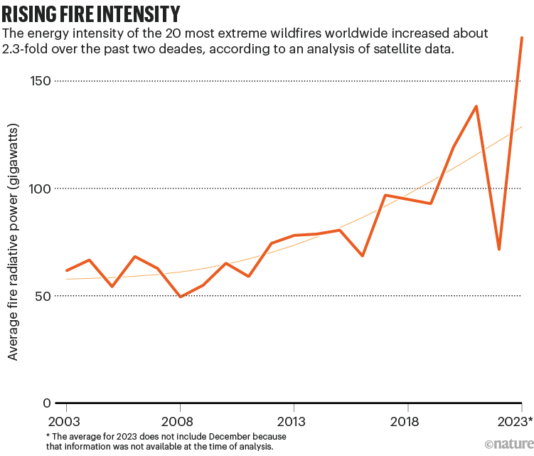
Wildfires are becoming more frequent and are more intense in the U.S.
Wildfires are necessary part of forest ecosystems, as they can reduce dead vegetation, stimulate new growth and improve habitat.
However, frequency of extreme wildfires more than doubled from 2003 – 2023
Cause of wildfires attributed to increasing temperatures and severe droughts.
https://hazards.fema.gov/nri/wildfire
(Cunningham et al. 2024)
https://www.nature.com/articles/d41586-024-02071-8

Slide 3
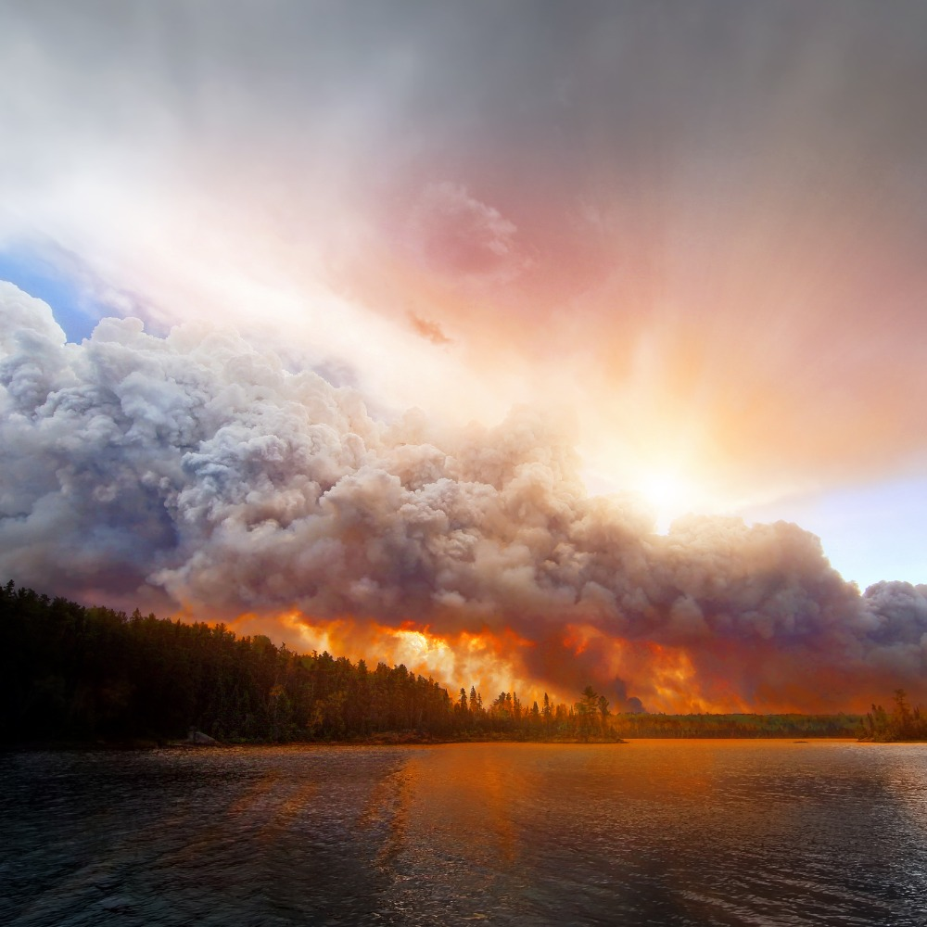
What are possible impacts of wildfires on water quality?​
https://cnr.ncsu.edu/news/2025/01/how-do-wildfires-impact-water-quality/

Slide 4
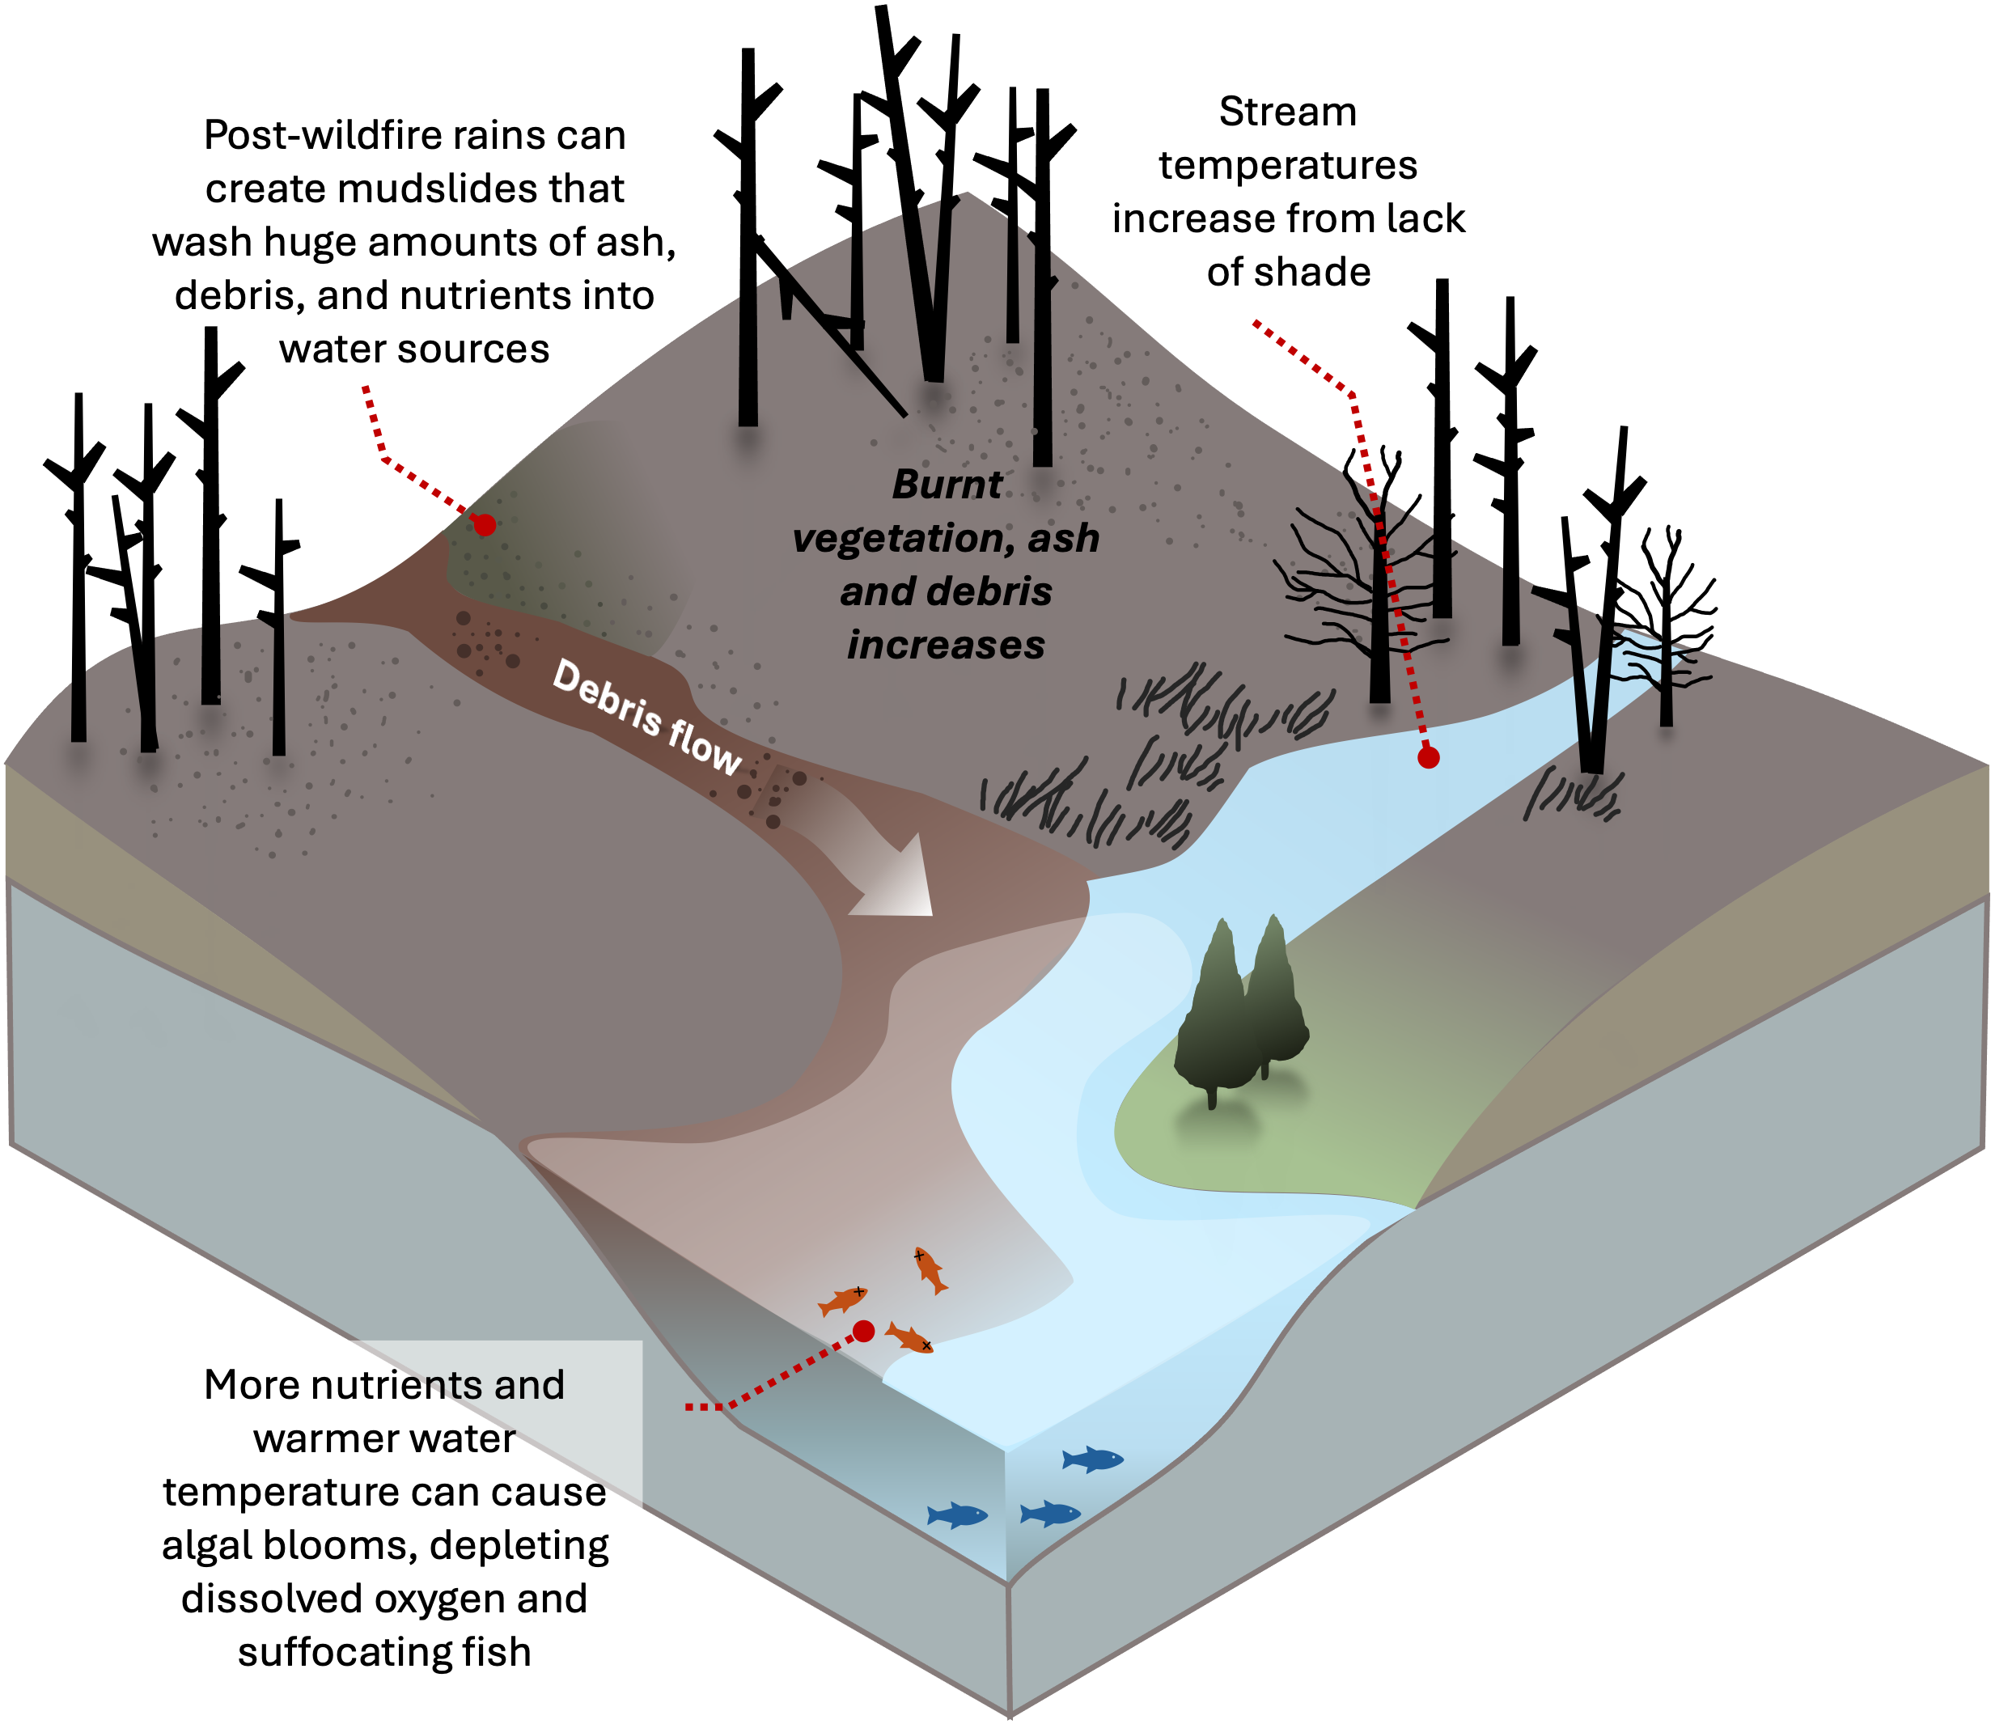
Impacts of wildfires on water quality
Burned hillslopes can increase soil erosion and mudslides
Due to lack of shade, stream temperatures can increase
Burning of vegetation can release ash and nutrients into air and water
Nutrients are substances that provide nourishment for growth
Nitrogen and phosphorous are key nutrients for algal growth
Increased water temperature encourages algal growth, potentially causing algal blooms

Slide 5
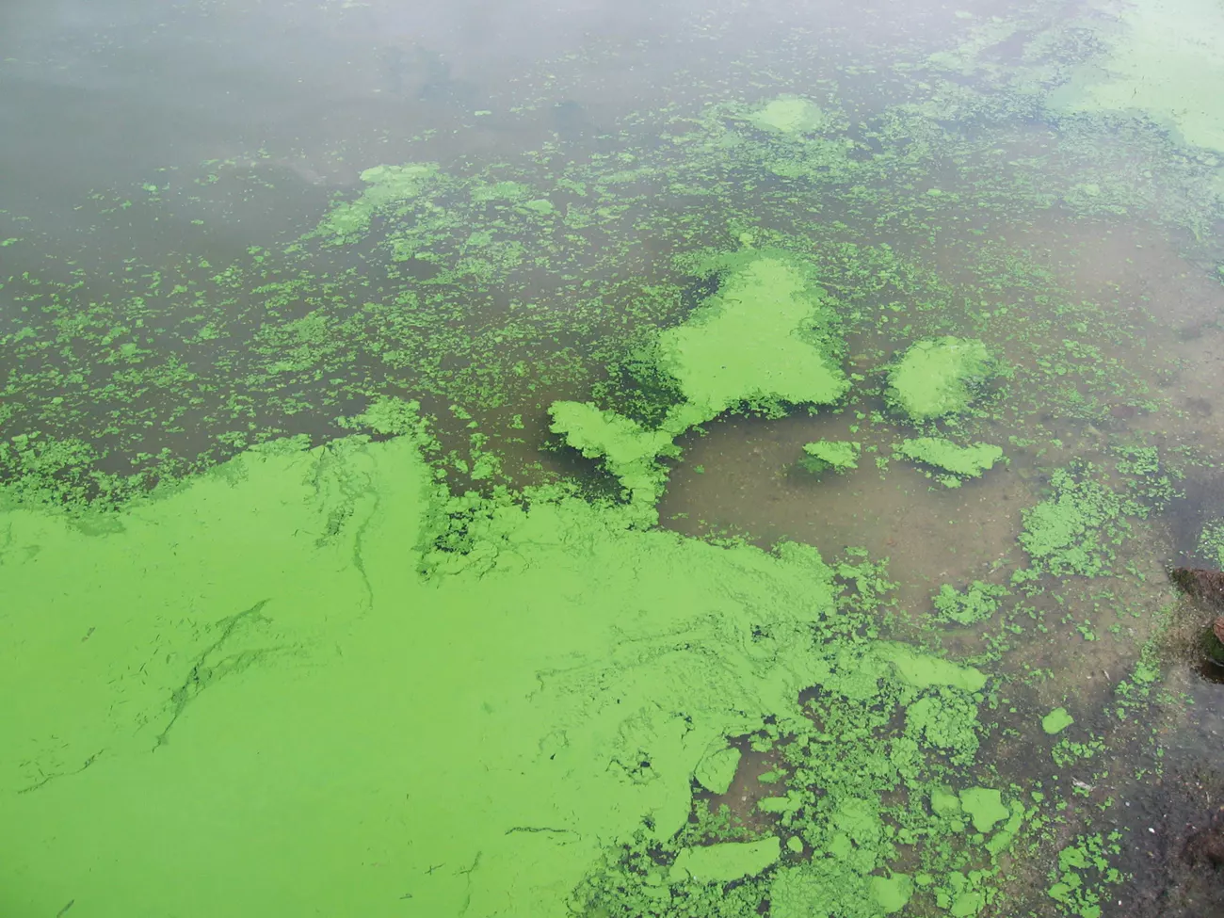
Algal blooms are harmful to water supplies and ecosystems
Algal blooms, or rapid increases in algae, are primarily caused by an excess of nutrients, particularly nitrogen and phosphorus, in water.
Nutrients can come from fertilizer, manure, and sewage … and also wildfires
Algal blooms cause depleted oxygen in water bodies, leading to fish kills.
Harmful algal blooms (HABs) are specific types of blooms that create toxins. These toxins can affect humans, shellfish, other wildlife and birds.
Notes:
From EPA
Several different types of algae can produce toxic HABs.
The most common algae associated with marine toxic HABs include the dinoflagellates (e.g., Florida red tide Karenia brevis) and diatoms (Pseudo-nitzschia)
Those most associated with freshwaters are dominated by cyanobacteria (e.g., Microcystis)

Slide 6
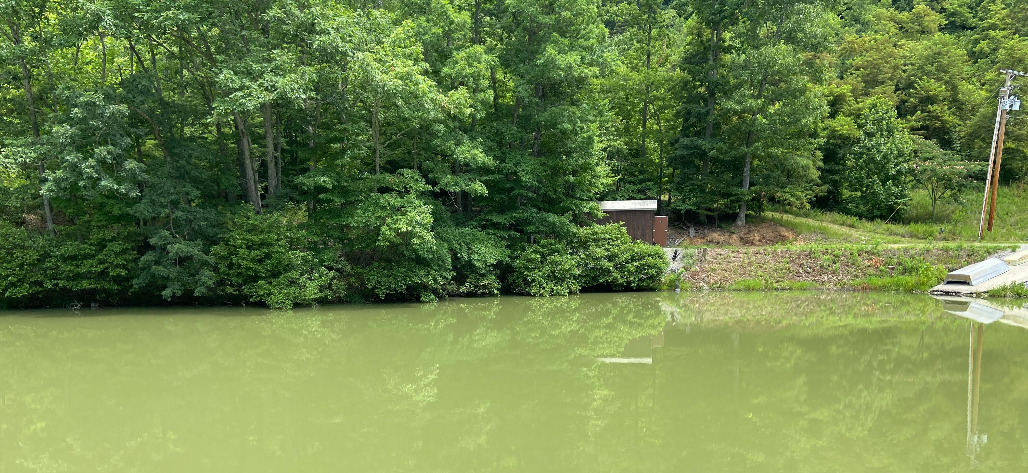
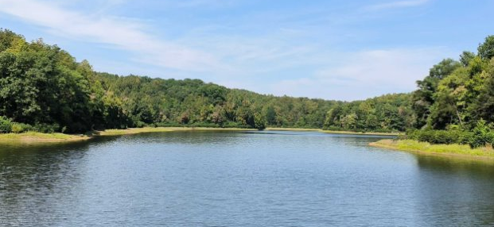
Which reservoir has an algal bloom?

Slide 7
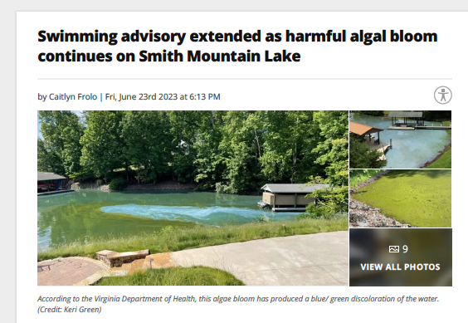
Algal blooms in drinking water reservoirs in SW Virginia
https://wset.com/news/local/swimming-advisory-extended-as-harmful-algal-bloom-continues-smith-mountain-lake-blackwater-arm-roanoke-sml-toxins-testing-vdh-department-health-environmental-services-june-2023

Slide 8
Lesson Summary: How can wildfires impact water quality in drinking water reservoirs in southwest Virginia?
In this lesson,
Students will review background material about the effects of wildfires on water quality and answer questions to check their knowledge.
Students will work with water quality data to investigate how wildfire impacts water quality in drinking water reservoirs and will answer questions to check their knowledge.

Slide 9
Student Learning Outcomes
After completing this lesson, students will be able to:
Describe the impact of wildfire burning on water quality.
Examine impacts of wildfire burning on nutrient inputs in a drinking water reservoir in southwestern Virginia using a data dashboard.
Plot and explore time series data from a data dashboard to investigate how nutrient inputs can increase algal growth.

Slide 10
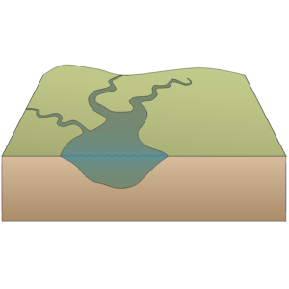


Creation of the data dashboard
Inflows
We used a hydrologic model to simulate inflows of water into a drinking water reservoir in southwestern Virginia. The reservoir has not experienced a wildfire.
Reservoir
Inflows
N, P
We looked for studies on reservoirs that had experienced wildfires. The studies measured concentrations of nutrients, nitrogen (N), and phosphorous (P), in inflows before and after wildfire.
We input the different concentrations of N and P from the studies into our model and then simulated scenarios of different burn intensities to generate N and P concentrations in the reservoir.
Inflows
N, P
We then simulated the impact of N and P on algal growth, using chlorophyll-A as an indicator of algae.

Slide 11
Workflow of the Data Dashboard
Start with baseline (non-burned) inflow N and P
Save and plug in new inflow file representative of burn scenario
Run Hydrologic Model (BVR GLM-AED)
Plug into shiny R app
Save new dataframe with new values from each scenario
Save output file with variables we want to show

Slide 12
Resources
You Tube Videos
https://youtube.com/playlist?list=PLr5bB3qcMRzS7TXGbmTYTkNRSTLtFNUrZ&feature=shared
https://www.youtube.com/watch?v=rrhz_kcYU2g&list=PLr5bB3qcMRzS7TXGbmTYTkNRSTLtFNUrZ&index=3
https://www.youtube.com/watch?v=Y9yEERskots&list=PLr5bB3qcMRzS7TXGbmTYTkNRSTLtFNUrZ&index=4
Websites
Wildland Fires Could Be Putting Your Health At Risk.
Water Quality After a Wildfire
Wildfires and Water
Benefits of Wildfire
Scientific Articles
Caldwell, P. V., Elliott, K. J., Liu, N., Vose, J. M., Zietlow, D. R., & Knoepp, J. D. (2020). Watershed‐scale vegetation, water quantity, and water quality responses to wildfire in the southern Appalachian mountain region, United States. Hydrological Processes, 34(26), 5188-5209.
Cunningham, C. X., Williamson, G. J., & Bowman, D. M. (2024). Increasing frequency and intensity of the most extreme wildfires on Earth. Nature Ecology & Evolution, 8(8), 1420-1425.
De Palma‐Dow, A., McCullough, I. M., & Brentrup, J. A. (2022). Turning up the heat: Long‐term water quality responses to wildfires and climate change in a hypereutrophic lake. Ecosphere, 13(12), e4271.
Murphy, S. F., Alpers, C. N., Anderson, C. W., Banta, J. R., Blake, J. M., Carpenter, K. D., ... & Ebel, B. A. (2023). A call for strategic water-quality monitoring to advance assessment and prediction of wildfire impacts on water supplies. Frontiers in Water, 5, 1144225.
Olson, N. E., Boaggio, K. L., Rice, R. B., Foley, K. M., & LeDuc, S. D. (2023). Wildfires in the western United States are mobilizing PM 2.5-associated nutrients and may be contributing to downwind cyanobacteria blooms. Environmental Science: Processes & Impacts, 25(6), 1049-1066.

